Slide 1
Job Hunting WEB application
Team Members: Asitava Mahapatra, PRAMOD REPAKA, Precious Osarenen, SOWMYA BADAM, Suhong Liang

Slide 2
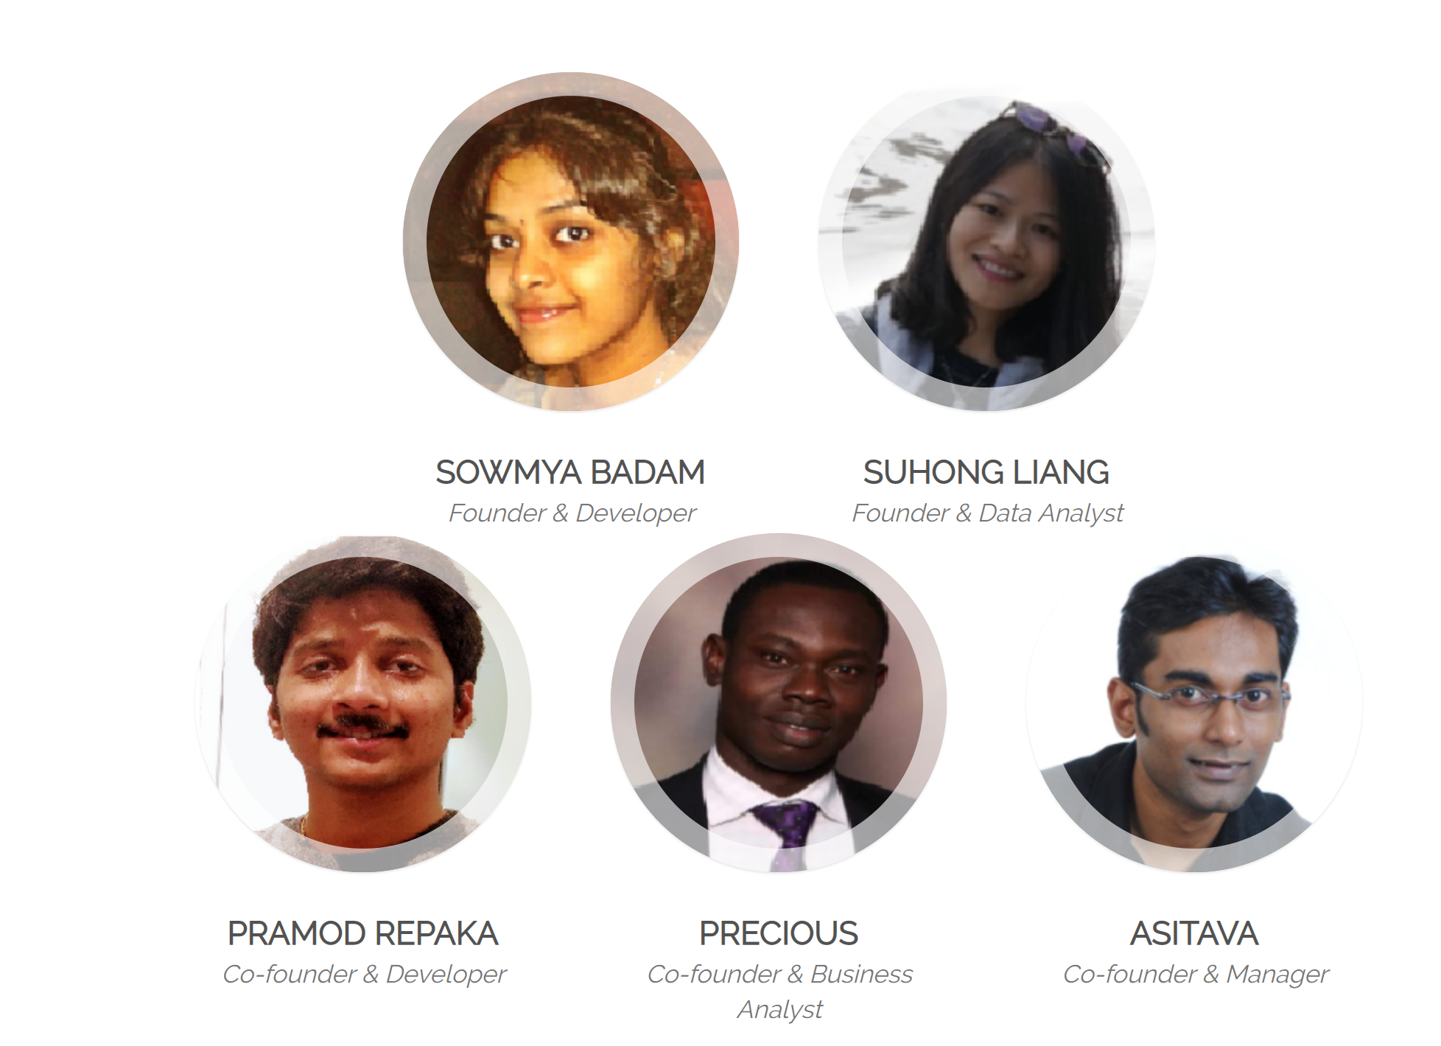
OUR TEAM

Slide 3
Project Summary For Job Hunter
Prepare
Prepare BRD
Develop
Develop The Website
Build
Build The Database
Connect
Connect The Website, Database and Data source
Prepare
Prepare Dynamic Visualization

Slide 4




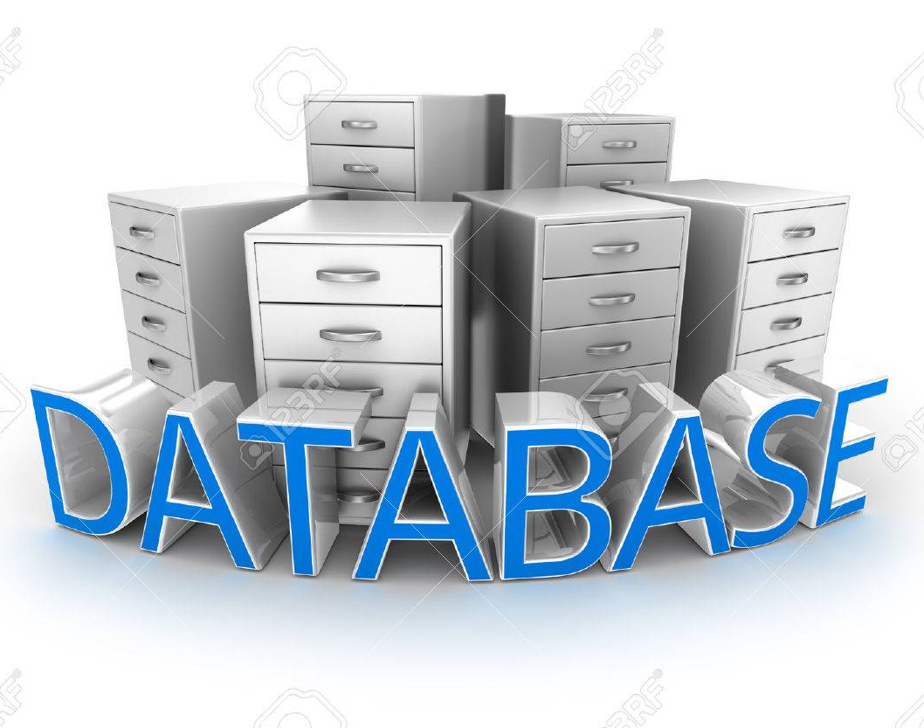
Notes:
Project summary and Who are we and what did we do

Slide 5
Business Background
The USA is one of the biggest job market
What kind of job is popular in USA ?
Which part of the USA has more opportunity to find a decent job?
Scrap data from Job API: Federal, state, and local government agencies are hiring and have thousands of job openings across the country, posted on USAJobs.gov and local government jobs sites.

Slide 6
Project manager & Business Analyst
Build
build the documentation for proposal
Collaborate
Collaborate with each team to ensure project deliverables are understood
Perform
Perform User acceptance testing (UAT) for the applications

Slide 7
Developers
Front and Backend developer
built a website using Python flask in which we are displaying the results from database
Built a cloud server using amazon aws
Built the Connection between the website and the database
scheduled scraping the Job website every 24hours using Python script
Using MongoDB on AWS, assist the data analyst in accessing the data
Notes:
We have actually scraped US govt. website and is scheduled to scrape for every 24hours using Python.
We are storing this data in MongoDB on AWS
We have built a website in Python flask in which we are displaying the results from database and also few visualizations are done using Google charts
Finally accessing the website from AWS online

Slide 8
Data Analyst
Initial Data Collection
Scrap Data
&
Store Data
Exploring
Data
Create a Dynamic Chart
ETL Process
Notes:
We have actually scraped US govt. website and is scheduled to scrape for every 24hours using Python.
We are storing this data in MongoDB on AWS
We have built a website in Python flask in which we are displaying the results from database and also few visualizations are done using Google charts
Finally accessing the website from AWS online

Slide 9





python
TOOLS
Google
Chart

Slide 10
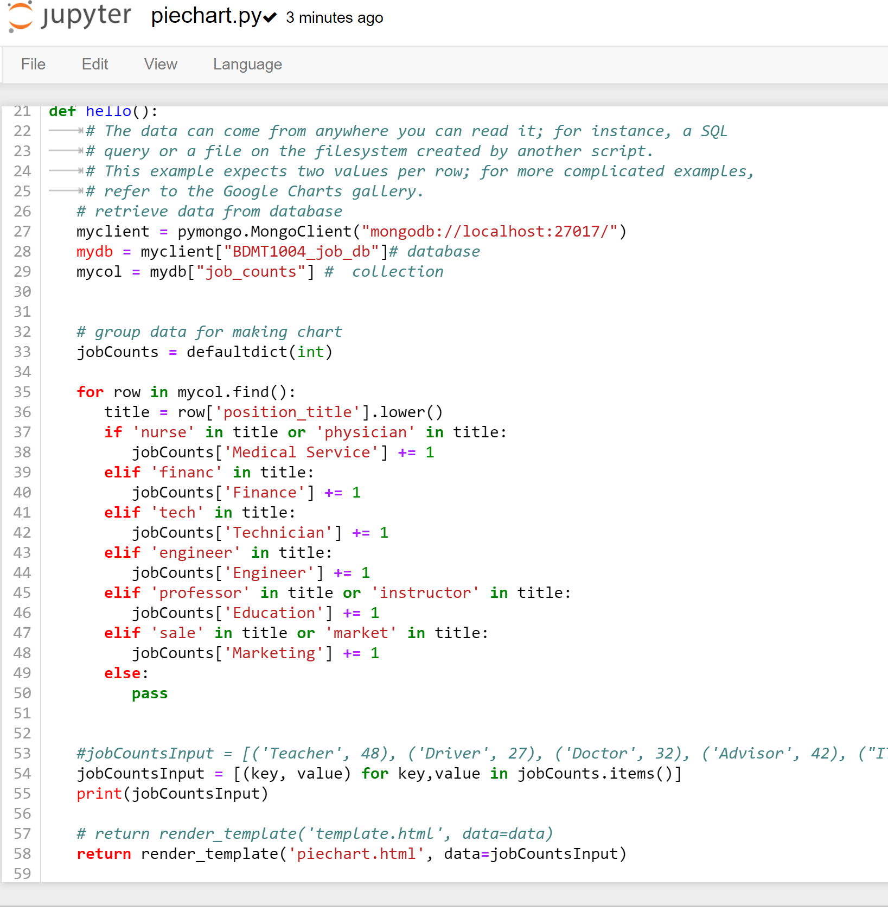
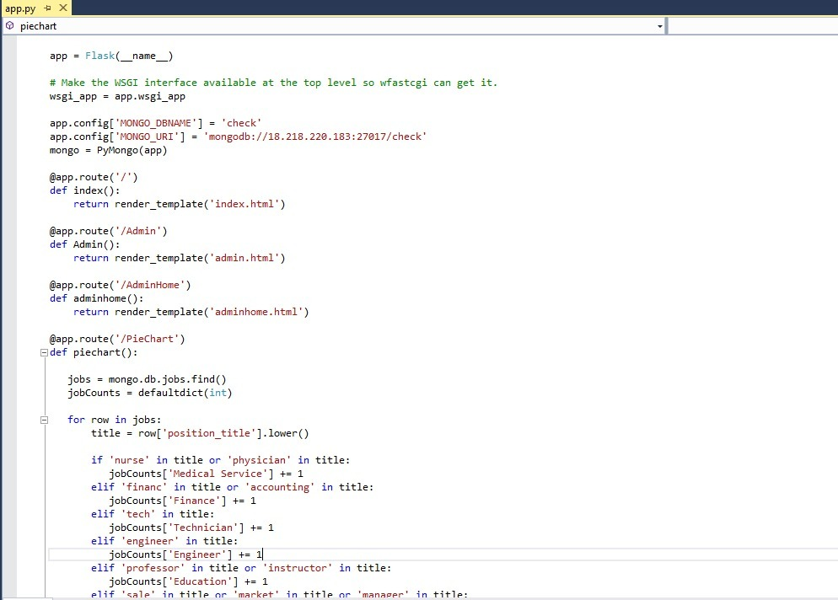
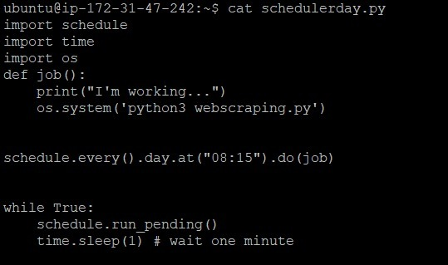
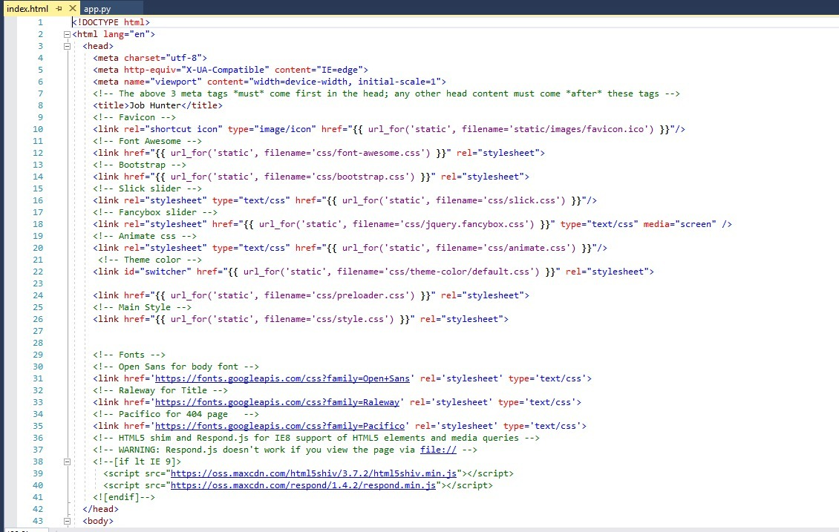
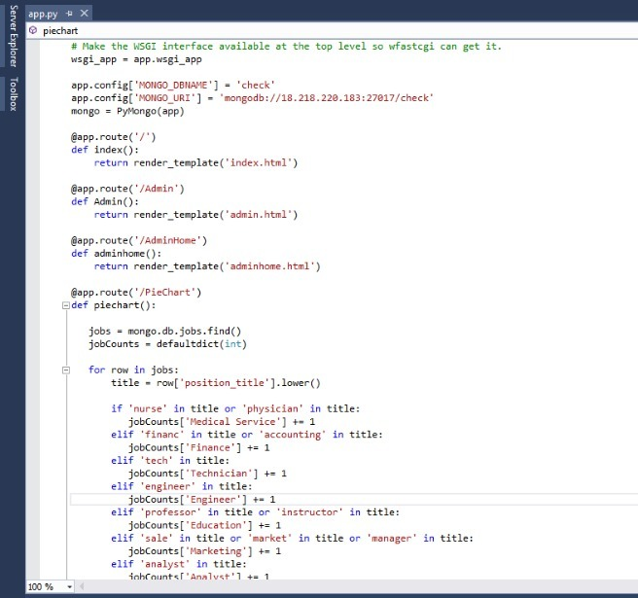
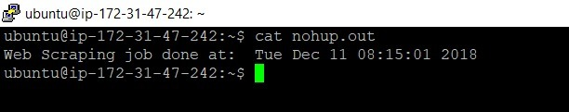
Glimpse of the codes

Slide 11
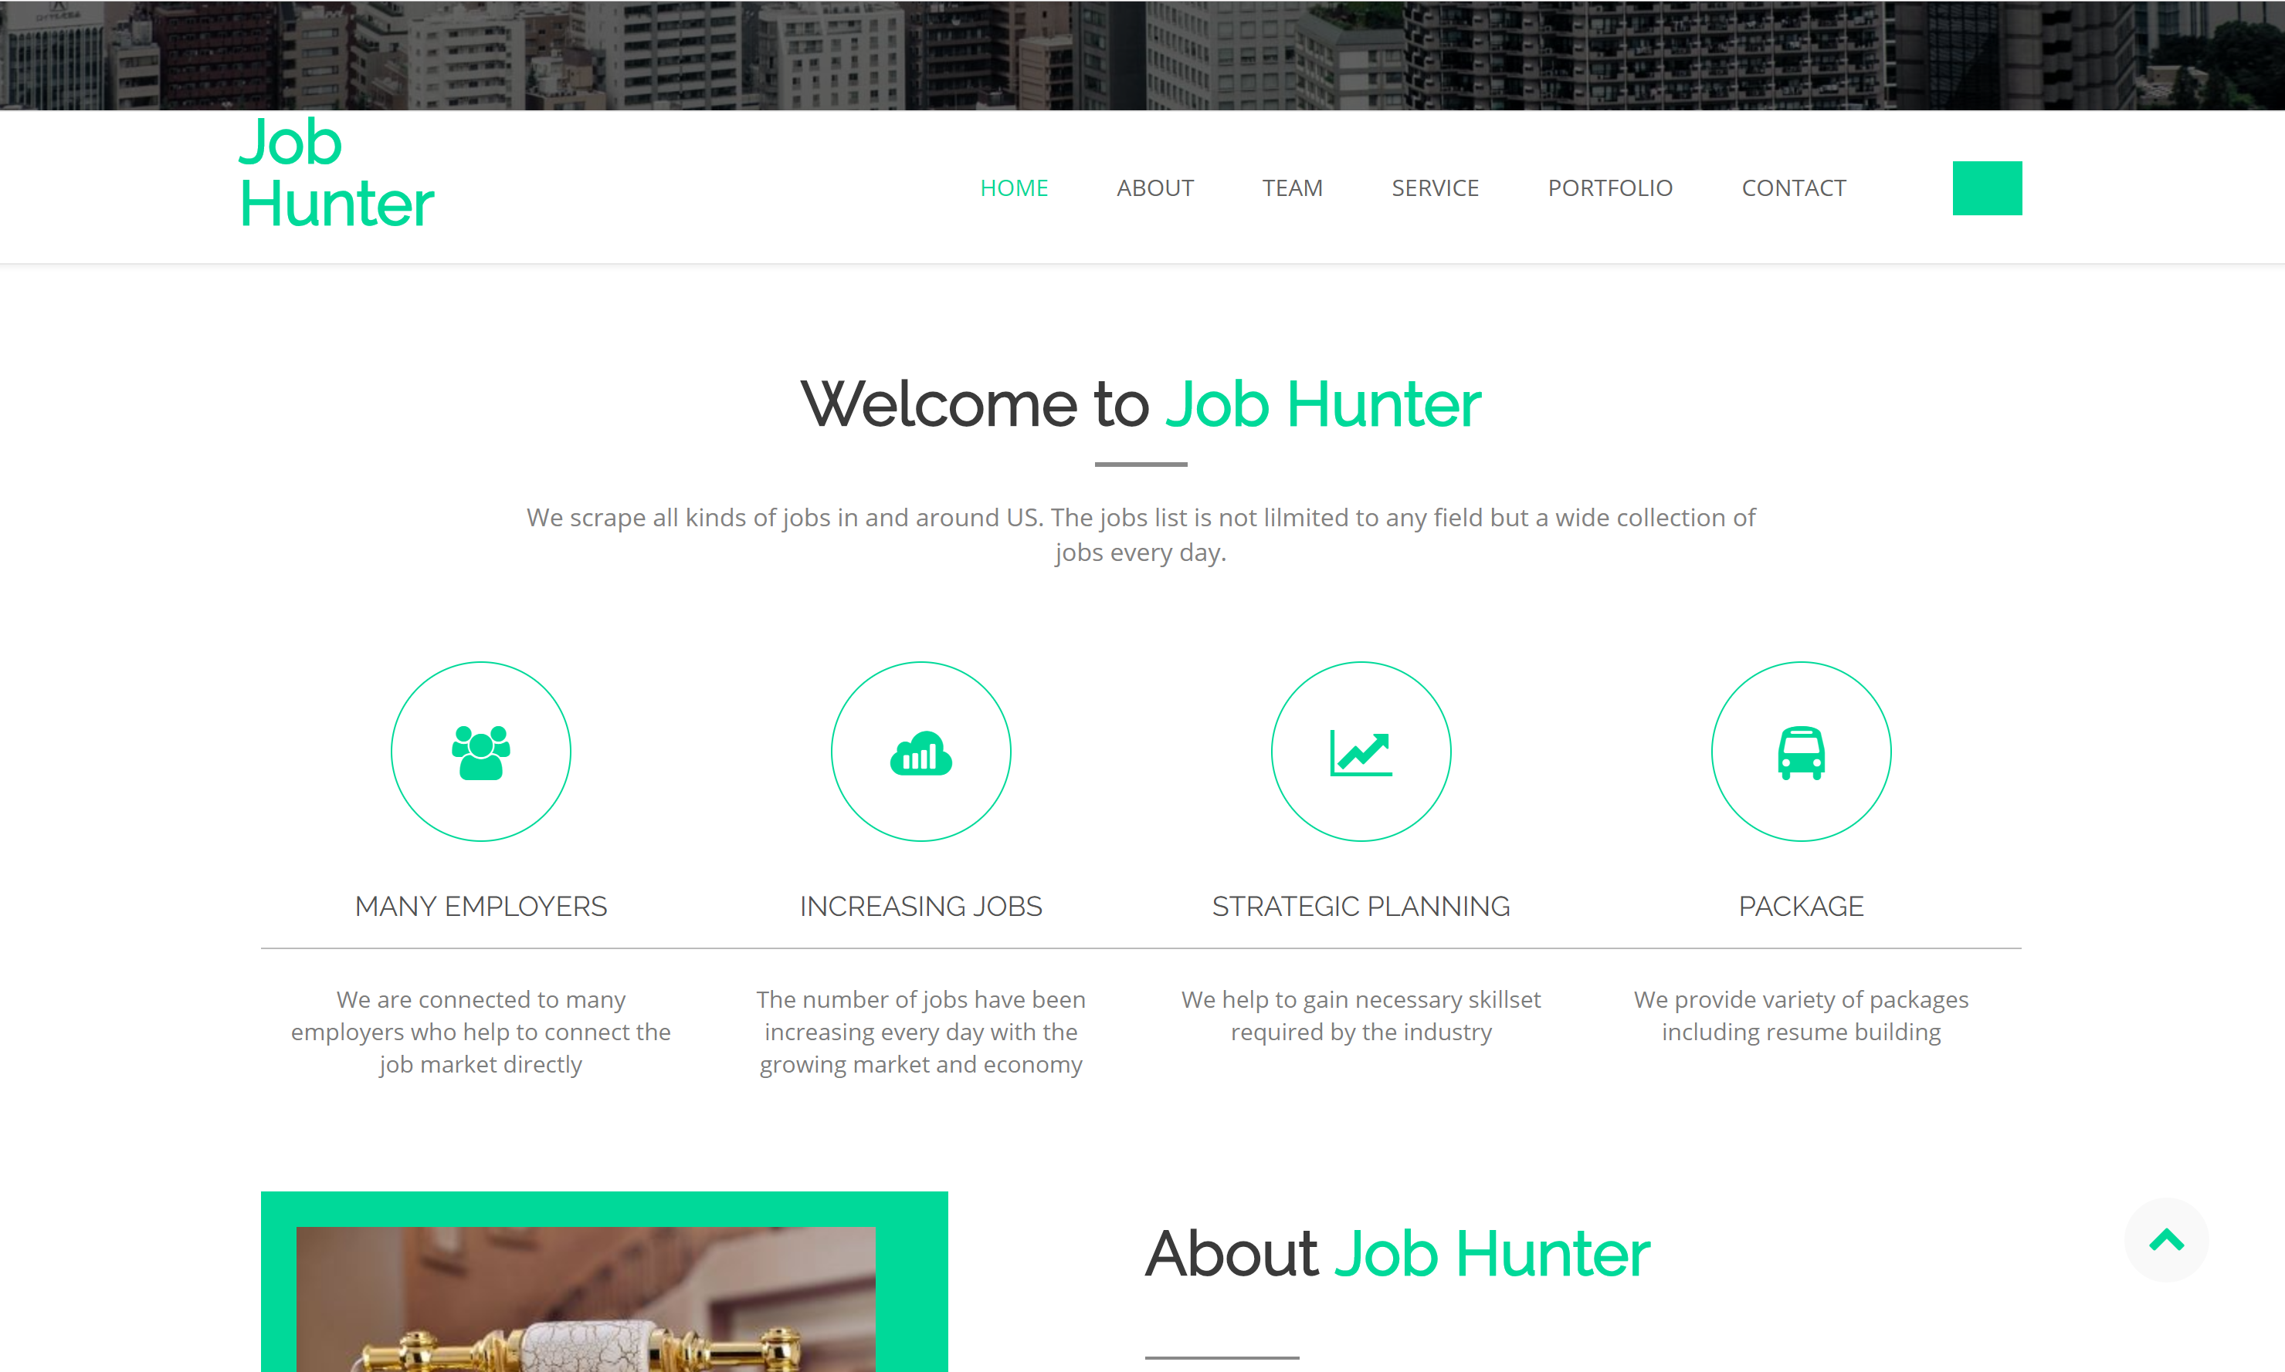
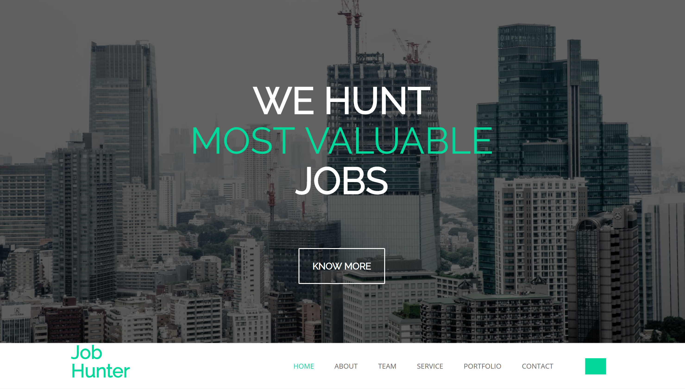
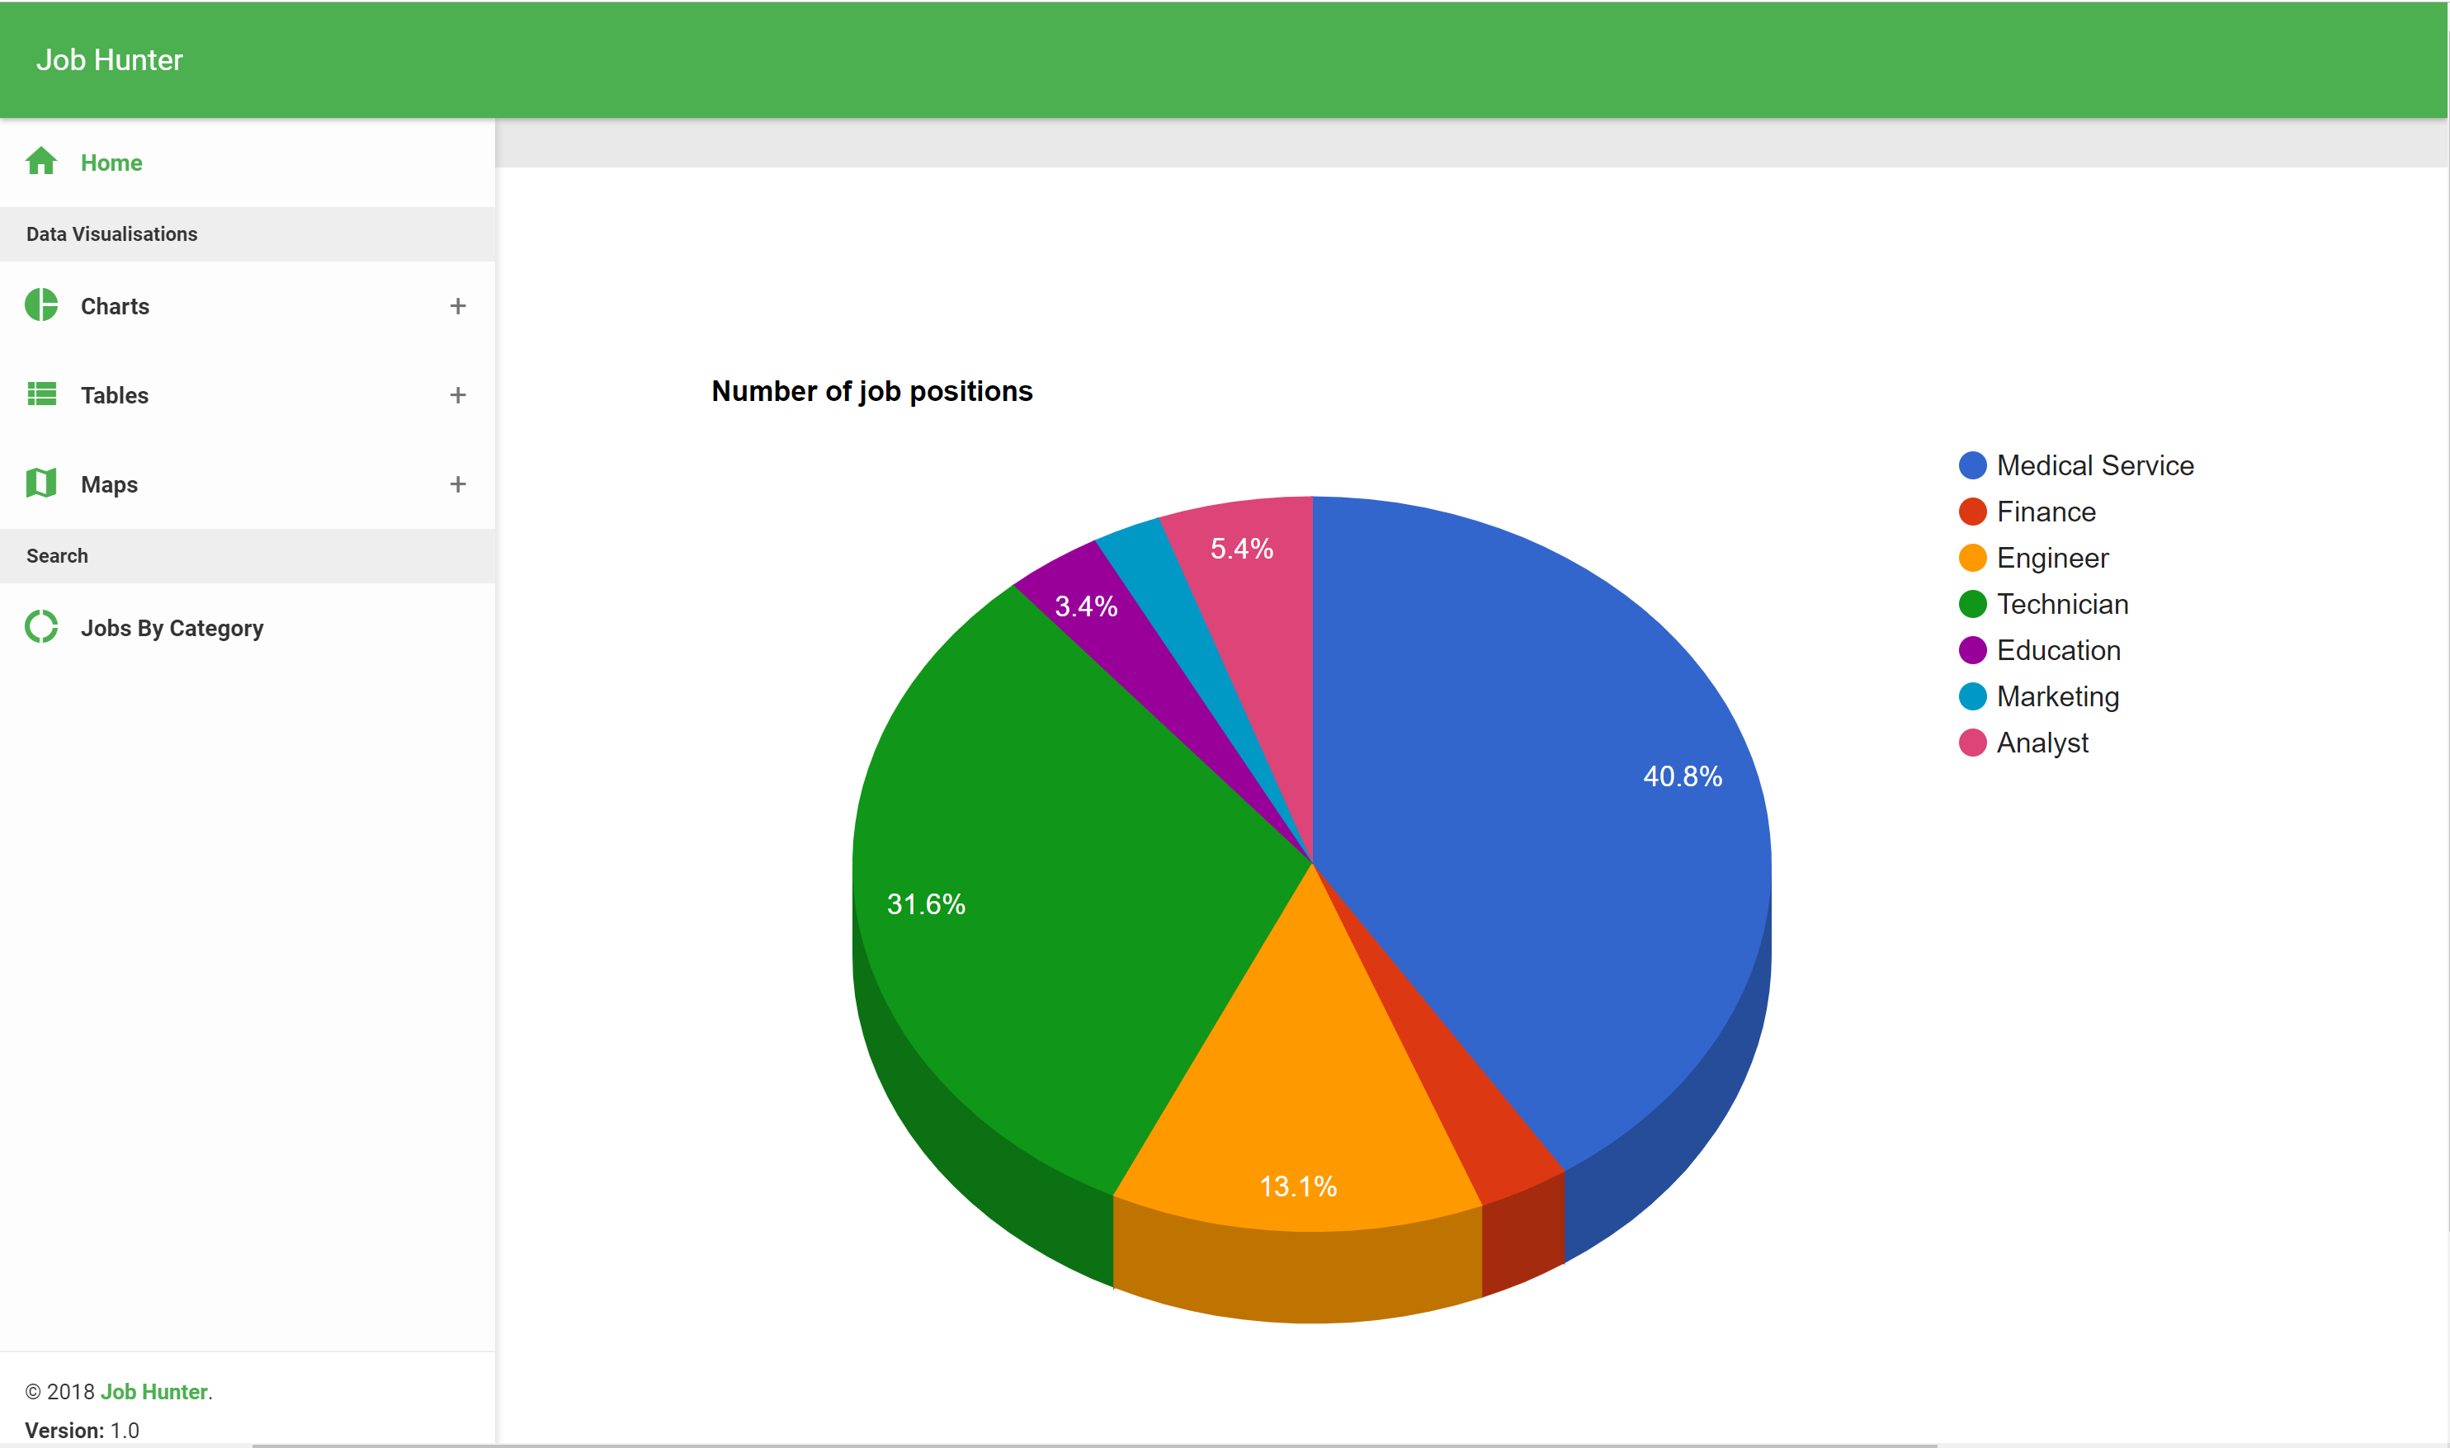
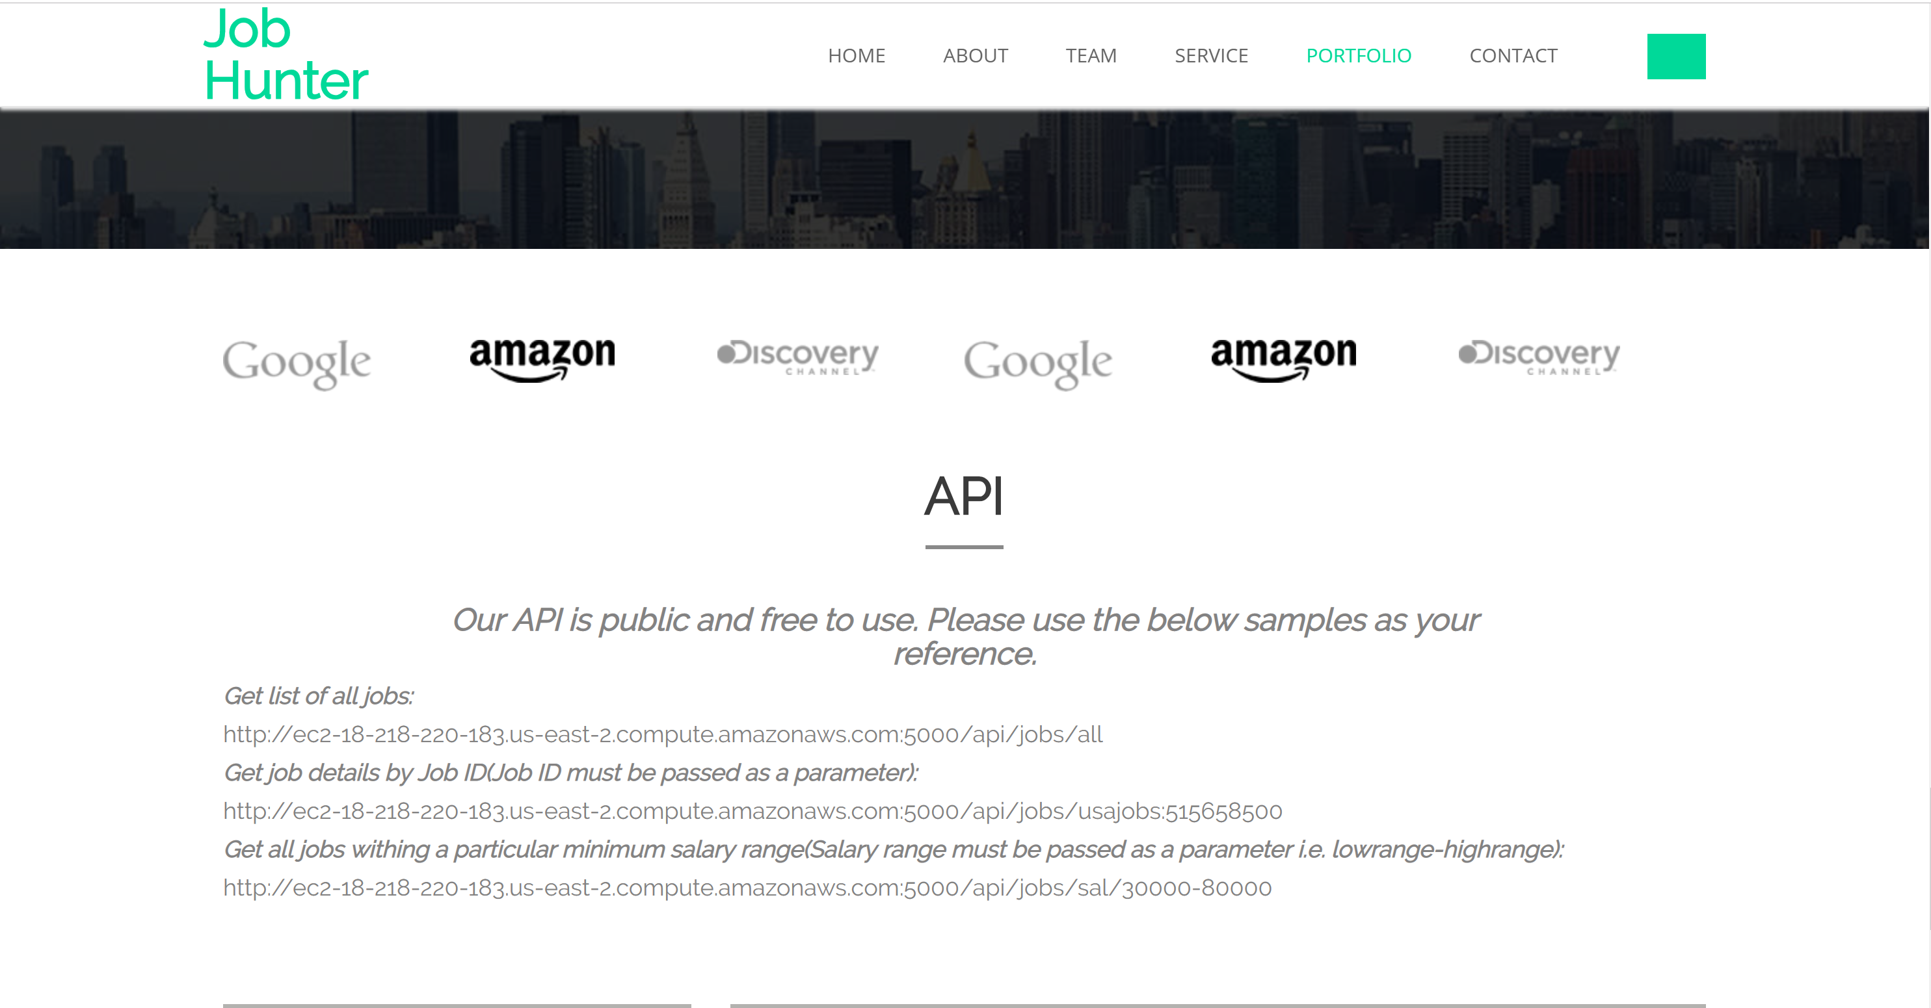
Website Glimpse

Slide 12
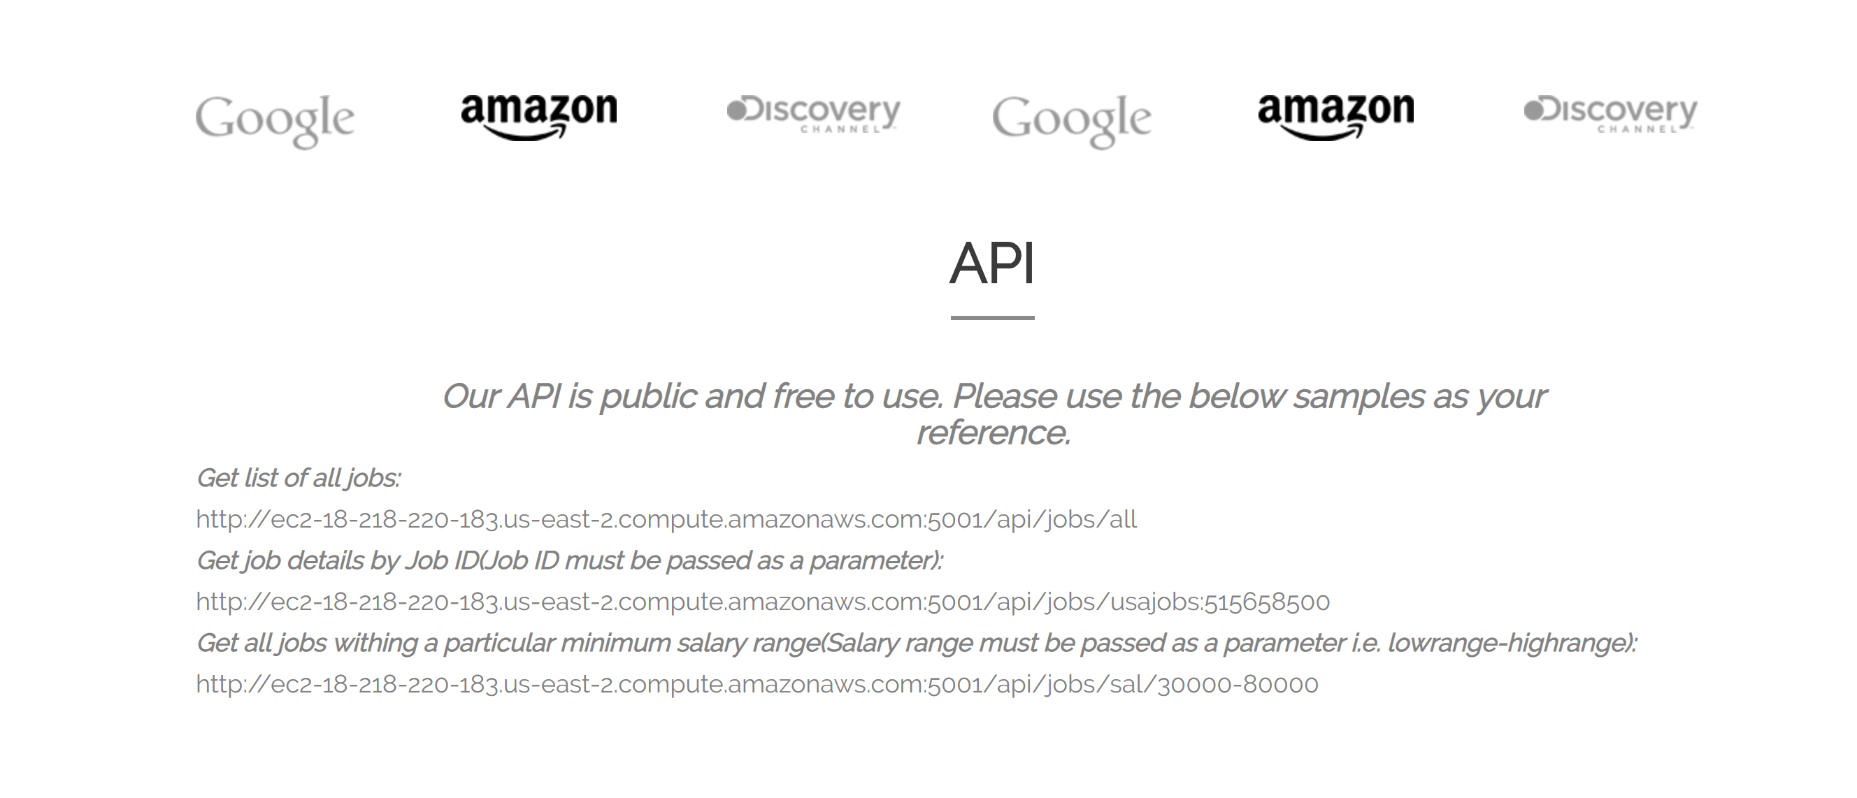
API
an API that serves data from the live cloud database
Get all list of jobs
Get all jobs within a salary range
Get jobs details by job id
Notes:
Developed public API using flask python
Build an API that serves data from the live cloud database
Get all items
Get a range of items
Get item by ID
Class should be able to use a URL to access the API and test

Slide 13
Let’s Visit our website
Job Hunter

Slide 14

Thank you and Questions

